Slide 1
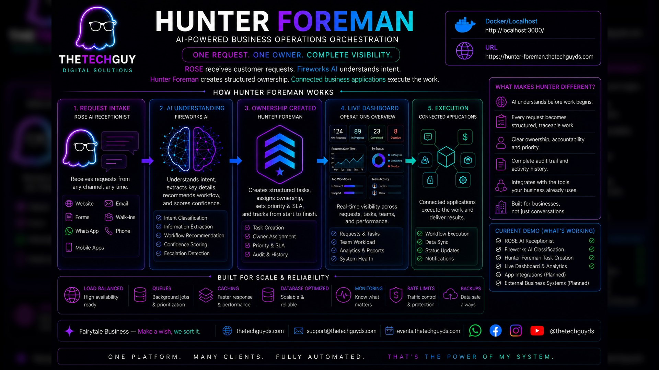

Slide 2
The Problem
Customer requests arrive everywhere. Ownership often does not.
Scattered intake
Work can disappear
No clean visibility
Requests arrive through websites, email, WhatsApp, social media, staff members, and walk-ins.
Without structured ownership, work can be forgotten, duplicated, delayed, or routed incorrectly.
Managers need one place to see ownership, status, and what changed.
Hunter Foreman turns every request into owned, traceable work.
BUSINESS OPERATIONS — NOT JUST CONVERSATION
02

Slide 3
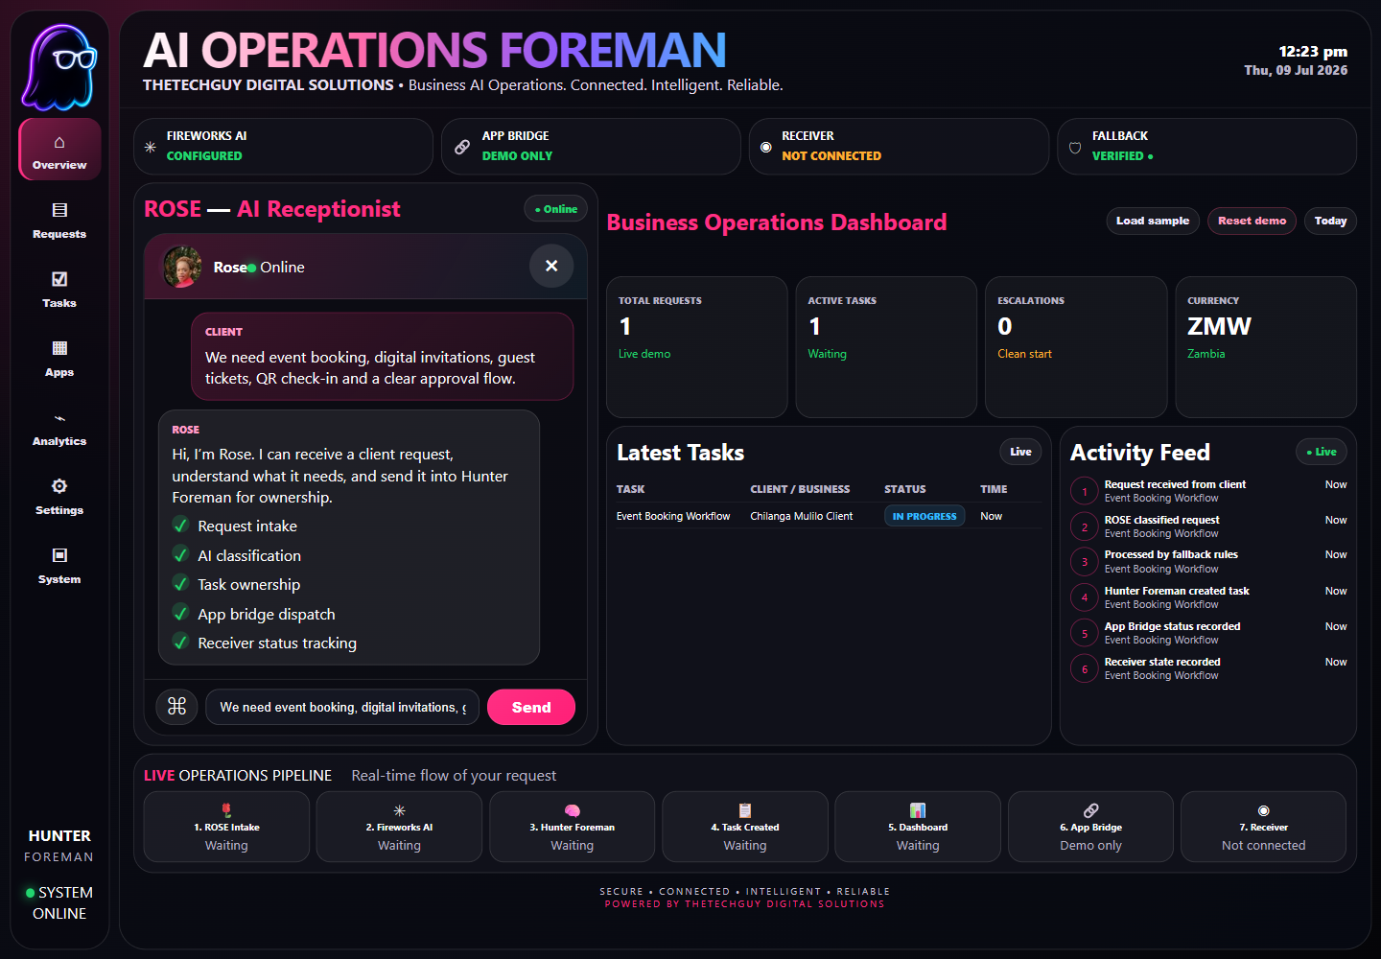
The Solution
ROSE intake, Fireworks understanding, Hunter Foreman ownership.
ROSE receives the customer request
Fireworks AI understands intent
Hunter Foreman creates the task and ownership path
The dashboard and task board reflect the work immediately
App Bridge and system state stay visible and honest
UNDERSTOOD • OWNED • TRACKED • VISIBLE
03

Slide 4
Fireworks AI Integration
Verified AI understanding produces structured operations signals.
accounts/fireworks/models/gpt-oss-120b
Live AI proof captured
Intent classification
Workflow recommendation
Confidence scoring
Escalation detection
Structured output for task creation
The proof package records provider output, confidence values, intent labels, and fallbackUsed=false for live classification cases.
Fallback is controlled
When provider credentials are absent, deterministic rules keep the demo safe and transparent instead of pretending live AI is available.
Verified implementation
Screenshots, API outputs, tests, checksums, and container instructions support the implementation directly.
04

Slide 5
Working Demo
Request intake, dashboard update, and activity visibility in one live view.
05

Slide 6
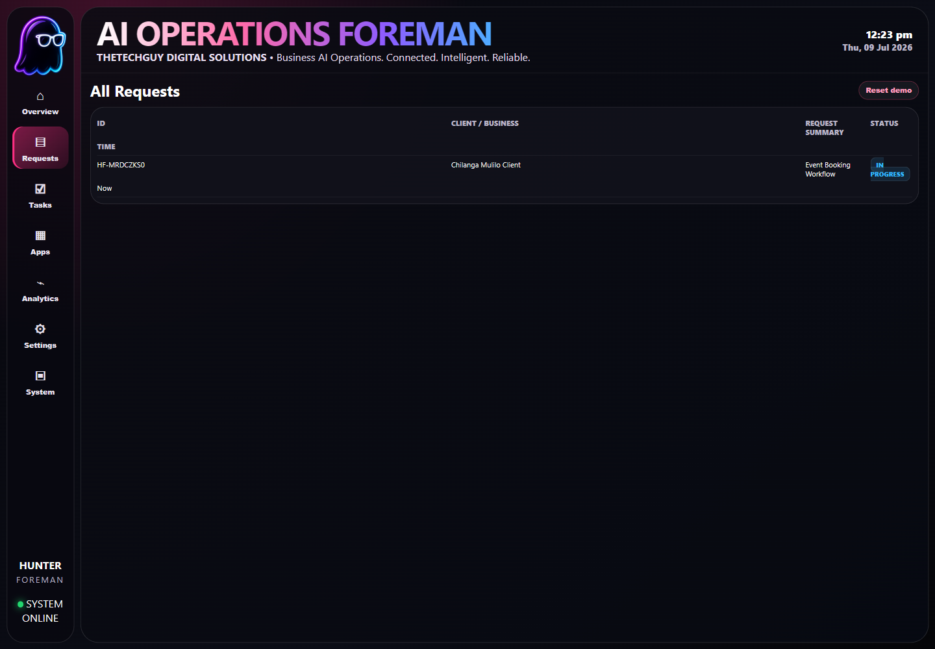
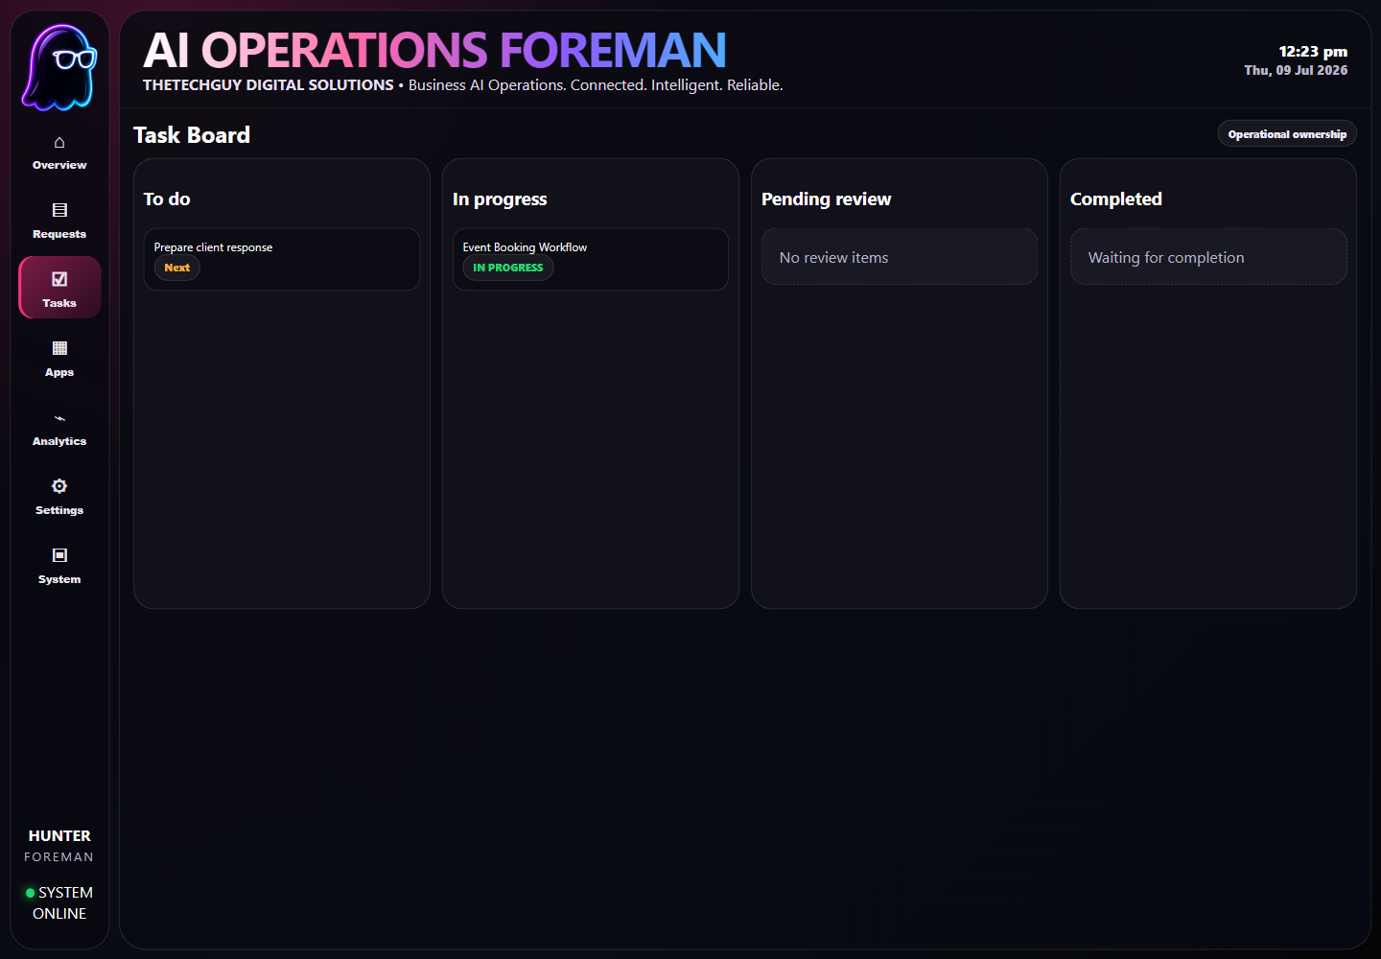
Ownership Proof
The request becomes visible in logs and operational work queues.
REQUESTS
TASK BOARD
06

Slide 7
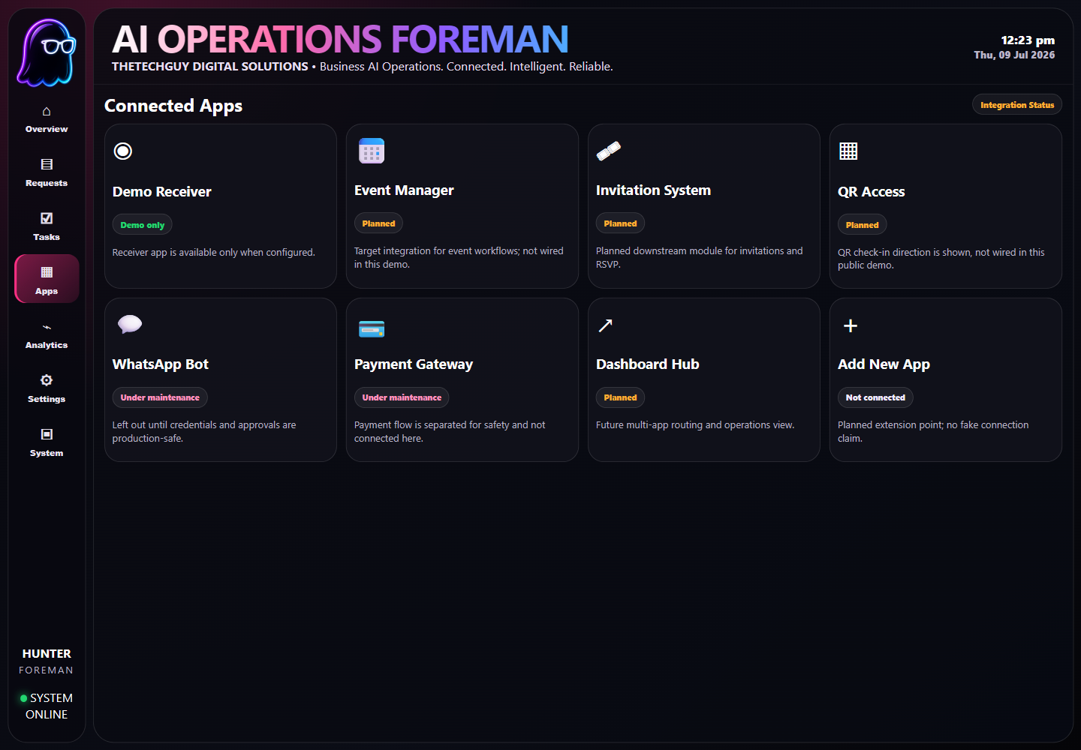
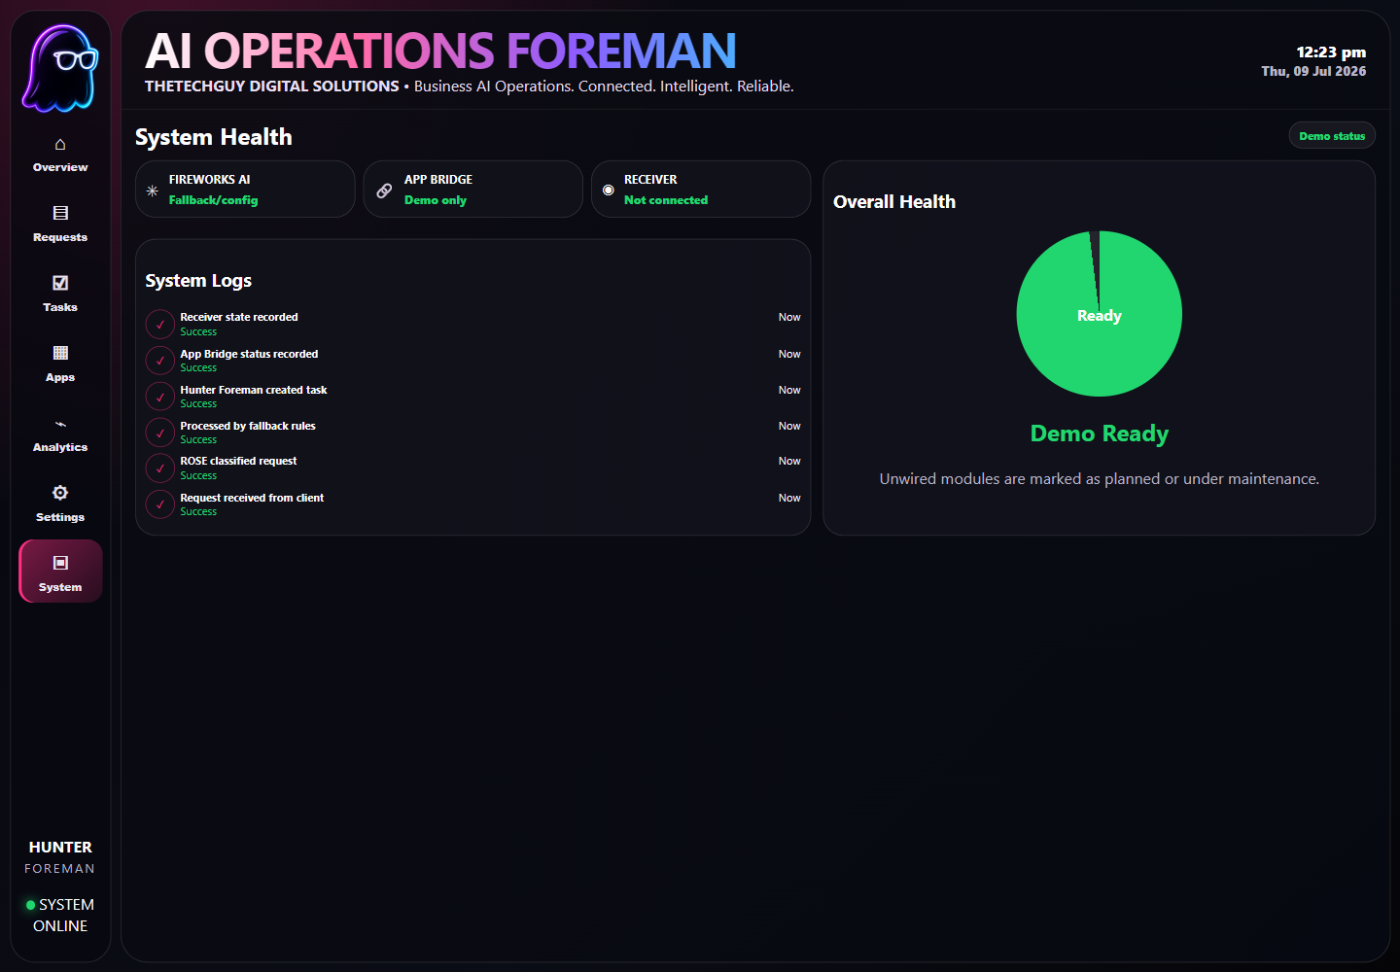
Operational Depth
Integration state and system health remain visible.
CONNECTED APPS
SYSTEM HEALTH
07

Slide 8
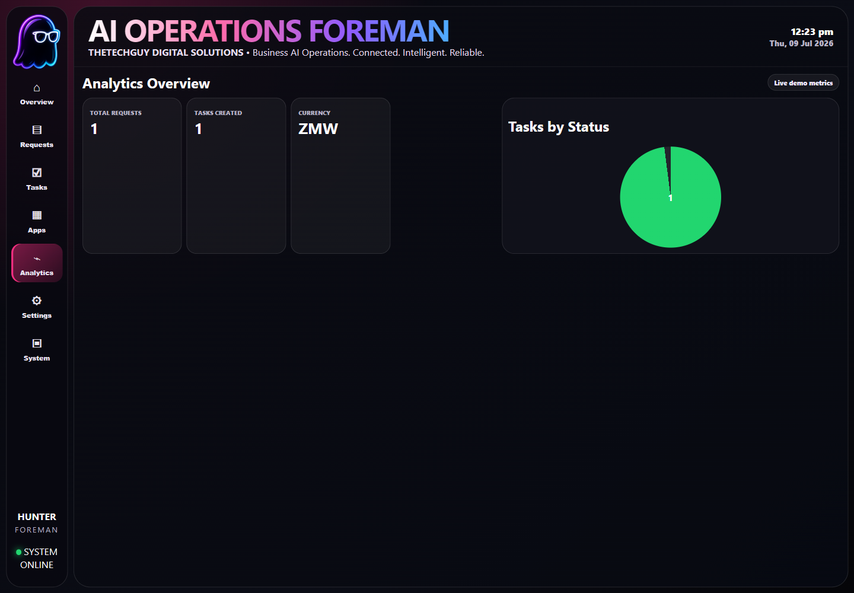
Analytics & Visibility
Operational counts and status visibility are built into the demo.
08

Slide 9
Verification & Container Proof
Every significant claim is backed by reproducible evidence.
Containerized app
Proof package
Tests
Dockerfile and docker-compose run the demo on port 3000.
Screenshots, walkthrough, API outputs, and SHA256 checksums.
Smoke tests, syntax checks, and Fireworks live proof.
Clean clone demo path
README visuals use optimized WebP assets
Planned integrations are shown honestly, not overstated
Live AI proof and deterministic fallback are both documented clearly
git clone https://github.com/jaydumisuni/hunter-foreman.git
cd hunter-foreman
docker compose up --build
open http://localhost:3000
09

Slide 10
Roadmap & Product Potential
From working demo to multi-business operations infrastructure.
Current
Business integrations
Platform expansion
ROSE intake, Fireworks classification path, task ownership, dashboard visibility, and proof artifacts.
WhatsApp, payments, event workflows, invitations, QR access, and business-specific receivers.
Multi-business deployment, stronger App Bridge contracts, additional AI providers, and monitoring.
Hunter Foreman is operations infrastructure: one request, one owner, complete visibility.
ONE PLATFORM. MANY CLIENTS. FULLY AUTOMATED.
10

